Slide 1
Quarkus
Moritz Müscher
Tiberiu Velcea

Slide 2
Today’s Agenda
What is Quarkus?
How does it work and why use it?
Developer Joy: Quarkus Dev Mode
Quarkus in the Cloud
Building microservices with Quarkus
Reactive programming with Quarkus
Quarkus & Hibernate
Quarkus vs Spring Boot
Best Practices
Limitations & Drawbacks
Quiz + Demo

Slide 3
What is Quarkus?
“Supersonic Subatomic Java” 🚀
Kubernetes-native Java framework
Optimized for GraalVM & OpenJDK HotSpot
Designed for fast startup, low memory, and developer joy
Ideal for microservices, serverless, cloud environments

Slide 4
How does it work?
Build-time metadata processing
→ moves reflection, scanning, config to build phase
Native Image support via GraalVM
Runtime optimised for small footprint
Unified programming model

Slide 5
Why Use It?
Fast startup & low memory → great for cloud/serverless
Live coding = higher productivity
Easy integration with MicroProfile, Hibernate, RESTEasy, Kafka, etc.
Cloud-ready out of the box (Kubernetes, OpenShift)
Fun to use — “Developer Joy” focus
Reactivity

Slide 6
Developer Joy: Quarkus Dev Mode

Slide 7
Dev Mode
mvn quarkus:dev = hot reload, no redeploys
Continuous testing built in (quarkus test)
Fast feedback → faster iteration
Watch files, auto-restart only changed parts

Slide 8
Quarkus in the Cloud
Minimal memory footprint → efficient containers
Native executables → perfect for serverless functions
Built-in extensions for Kubernetes, OpenShift, AWS, Azure, etc.
Fast scale-up / scale-down

Slide 9
Building Microservices with quarkus

Slide 10
RESTEasy, Panache
RESTEasy: Simple JAX-RS REST endpoints
  @Path, @GET, @POST for clean HTTP APIs
Panache: Opinionated persistence layer
  ActiveRecord or Repository style with minimal boilerplate
CDI (Contexts & Dependency Injection):
  @Inject for wiring services, config, and beans
  Scoped beans for request, application, etc.
Config: Unified configuration system
  application.properties / application.yaml
  Profile-specific config for dev / test / prod

Slide 11
How Quarkus Simplifies Microservices Development
Fast startup & low memory footprint
  Ideal for microservices and serverless
Dev services & auto-config
  Spin up DBs / Kafka containers automatically in dev
Consistent developer experience
  Same code works in JVM mode & native
Built-in Kubernetes / OpenShift support
  Extensions for health checks, metrics, config, tracing
Opinionated, but flexible
  Sensible defaults, override only when needed
Notes:
Microservices usually mean many small services — so startup time and memory usage really matter.
Quarkus is optimized for containers and native images, which keeps resource usage low.
Quarkus Dev Services make local development much easier: we don’t have to manually start external services like databases.
Extensions for health, metrics and tracing give us production-ready building blocks.
Overall, Quarkus is opinionated: it pushes us towards a certain way of building microservices — but we can still customize when needed.

Slide 12
Reactive programming with quarkus

Slide 13
Reactive Programming with Quarkus
Why reactive?
  Handle many concurrent requests with fewer threads
  Better resource usage for I/O-heavy services
Mutiny – Quarkus reactive programming API
  Types: Uni<T> (single result), Multi<T> (stream)
  Fluent, event-driven pipelines
Notes:
Reactive programming is about handling lots of concurrent work efficiently, especially when we wait on external systems like databases or APIs.
Quarkus uses Mutiny as its main reactive API, with Uni for single results and Multi for streams.

Slide 14
Reactive Programming with Quarkus
Reactive REST & messaging
  RESTEasy Reactive for high-performance HTTP
  Integration with Kafka, AMQP, etc.
Non-blocking I/O
  Based on Vert.x under the hood
  Avoids blocking threads for network / DB calls
Use cases
  Streaming APIs, event-driven architectures, high-throughput services
Notes:
RESTEasy Reactive is optimized for reactive I/O and gives better performance in many scenarios.
Under the hood, Quarkus uses Vert.x — a toolkit for reactive, non-blocking applications.
This is especially powerful for event-driven systems, streaming, and where we expect bursts of traffic.

Slide 15
Quarkus with hibernate

Slide 16
Quarkus & Hibernate ORM / Panache
Hibernate ORM integration
  JPA annotations: @Entity, @Id, @OneToMany, …
  Works in JVM & native mode (with some constraints)
Panache Entity / Repository
  Less boilerplate: built-in persist(), find(), listAll()
  ActiveRecord style (MyEntity.find("name", name))
Notes:
Quarkus integrates tightly with Hibernate ORM, so most JPA knowledge transfers directly.
Panache adds convenience on top by giving us simple CRUD methods without writing repositories for everything.

Slide 17
Quarkus & Hibernate ORM / Panache
Database support
  PostgreSQL, MySQL/MariaDB, Oracle, etc.
  Dev Services for automatic dev DB startup
Schema management
  hibernate.hbm2ddl.auto for simple setups
  Or use Flyway / Liquibase for serious migrations
Caching & performance
  Second-level cache, query tuning, lazy loading
Notes:
We can use standard relational databases, and for development Dev Services can start a containerized DB for us automatically.
For real projects, we typically use tools like Flyway or Liquibase instead of relying on Hibernate auto-creation in production.
Tuning Hibernate is still important: understanding lazy loading, batching and caching is key for performance.

Slide 18
Comparison to other Java Frameworks

Slide 19
Quarkus vs Spring Boot
-> Spring Boot is a mature Java framework that simplifies building production-ready applications by auto-configuring Spring components providing embedded servers, and offering a vast ecosystem of integrations.
-> In action Quarkus used about 15% of the CPU from the previous Spring solution, about 12% of the memory from before and on Startup a great difference from 15 seconds to 1-2 seconds.

Slide 20
Quarkus vs Micronaut
-> Micronaut is a lightweight, JVM-based framework designed for fast startup and low memory usage, using ahead-of-time dependency injection instead of reflection.
-> In practice Quarkus still boots faster—especially in native mode—often by 20–40%, and provides richer developer tools like Dev UI and continuous testing.
-> Quarkus generally delivers slightly lower memory consumption under load and offers a broader cloud-native extension ecosystem out of the box.

Slide 21
Quarkus vs Helidon
-> Helidon is Oracle’s cloud-native Java framework, offered in two flavors: Helidon SE (pure reactive) and Helidon MP (MicroProfile-based).
-> Quarkus typically achieves faster startup and lower runtime memory usage due to deeper build-time optimizations and native-first design.
-> Quarkus provides a more extensive extension catalog, better tooling (Dev Mode, Dev UI), and smoother developer experience for Kubernetes and serverless workloads.

Slide 22
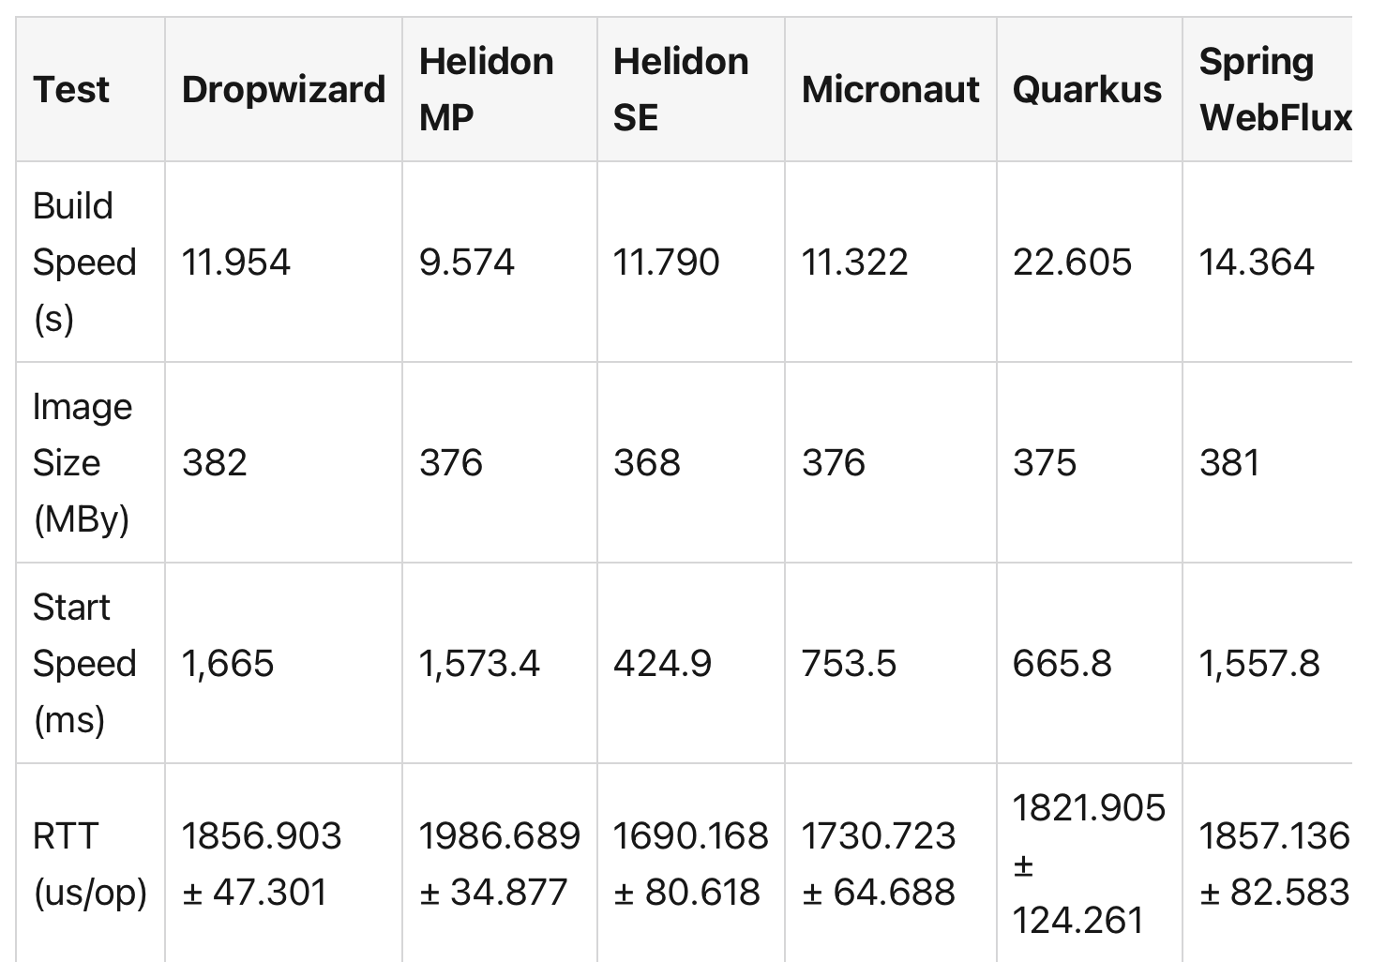
Comparison Charts
Important: These results depend greatly on app size, environment, and build mode — use them as guidance, not absolute truth.

Slide 23
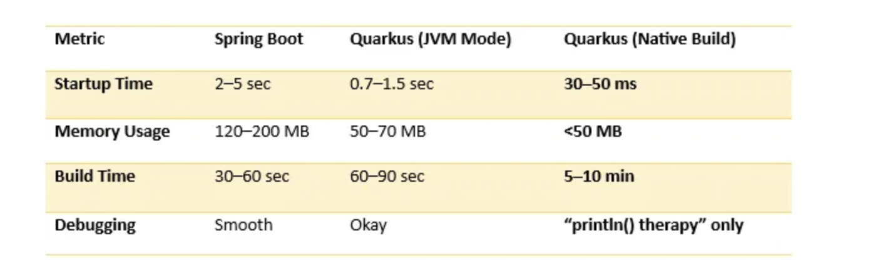
Comparison Charts

Slide 24
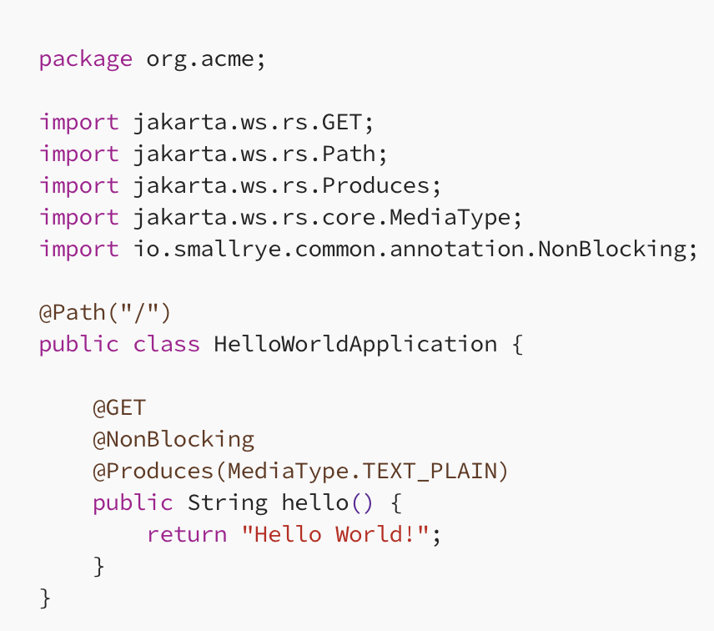
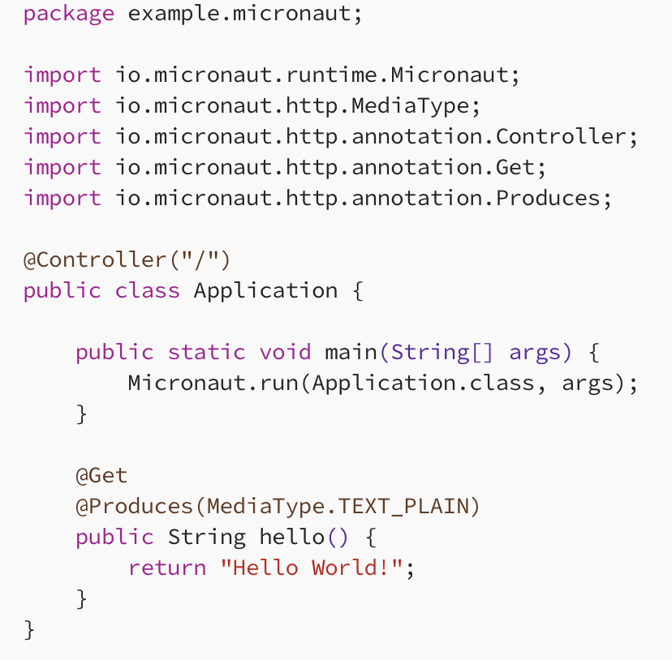
Comparison Charts: HelloWorld Code

Slide 25
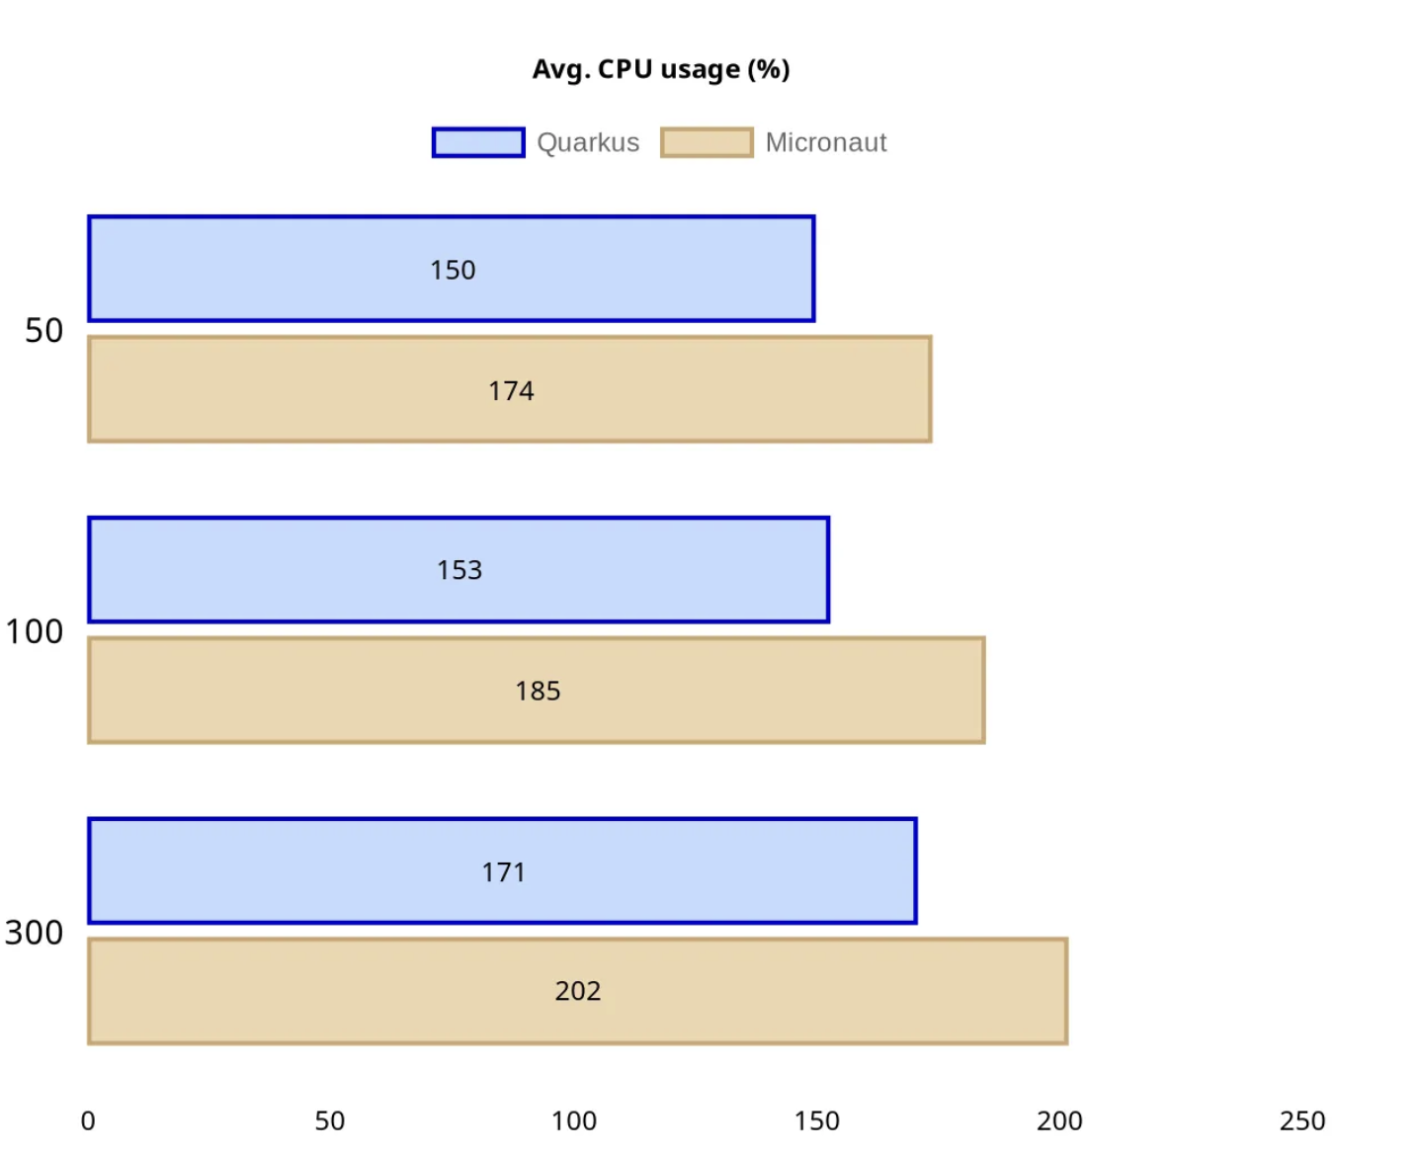
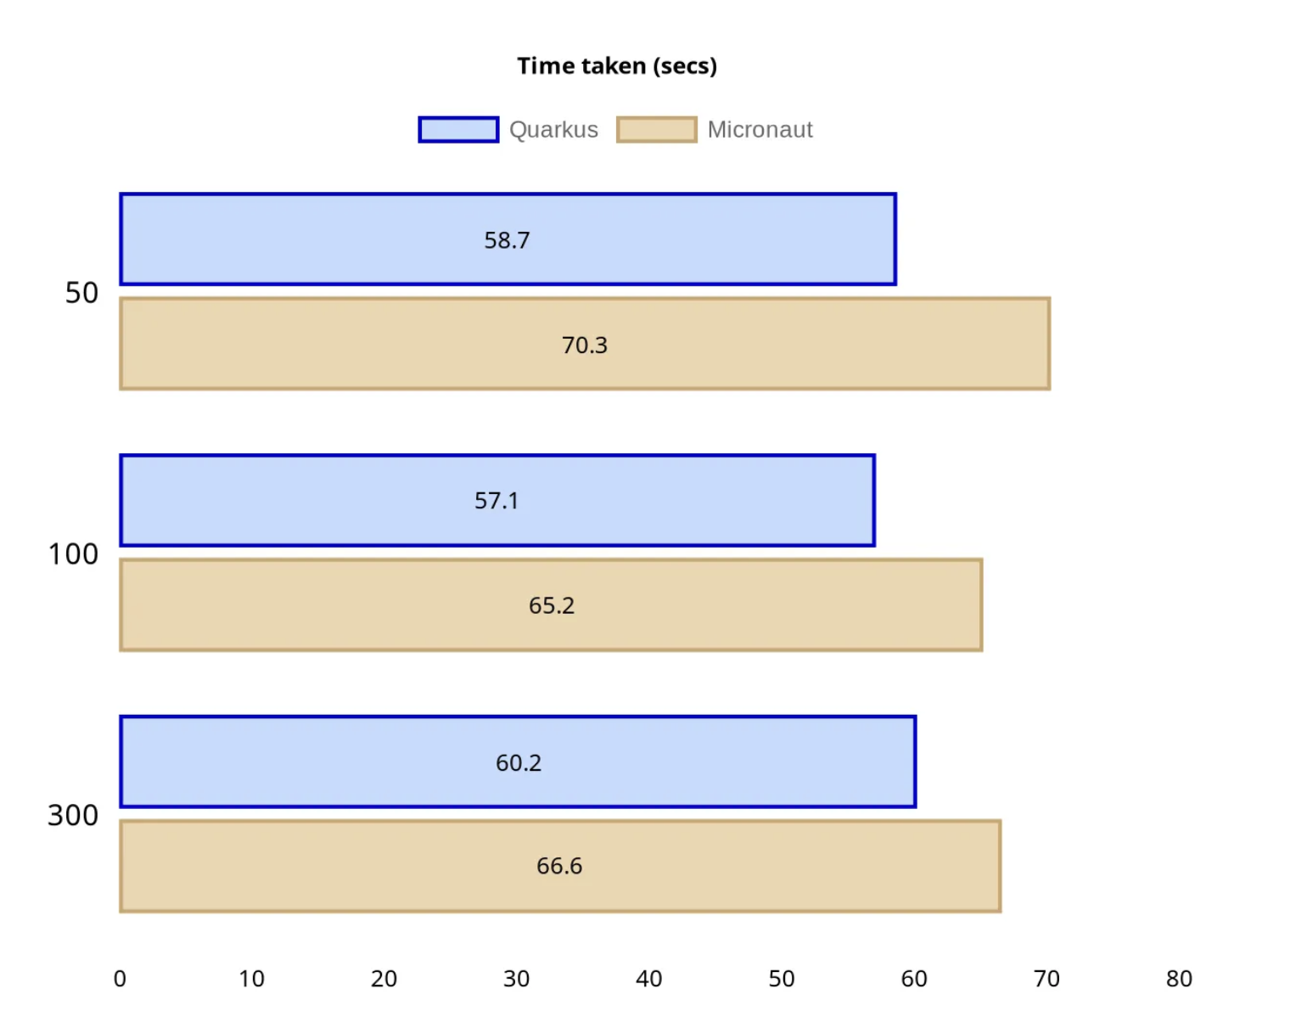
HelloWorld results

Slide 26
Best practices

Slide 27
Best Practices for Quarkus
Keep build time optimizations in mind
Use config profiles for env separation
Leverage Panache ORM for simplicity
Use reactive where performance matters
Test native & JVM modes early
Keep container images small

Slide 28
Limitations & drawbacks

Slide 29
Limitations & Drawbacks
Learning curve & ecosystem maturity
  Smaller ecosystem vs. Spring Boot
  Fewer tutorials / StackOverflow answers
Native image constraints
  GraalVM native requires reflection config, etc.
  Some Java libraries don’t behave well in native mode
Notes:
Quarkus is powerful, but not a silver bullet.
Compared to Spring Boot, the ecosystem and community are still smaller, which can make troubleshooting harder.
Native images bring great performance but also technical complexity, especially with reflection-heavy libraries.

Slide 30
Limitations & Drawbacks
Opinionated structure
  “Quarkus way” of doing things; less freedom in some areas
Tooling & debugging
  Native debugging more complex than JVM mode
Migration effort
  Migrating large Spring apps to Quarkus can be non-trivial
  Different defaults (config, security, etc.)
Notes:
Quarkus is opinionated — if your team likes total flexibility, this can sometimes feel restrictive.
Migration from large existing Spring landscapes requires real effort — especially around security, configuration, and library compatibility.

Slide 31

Quiz time

Slide 32
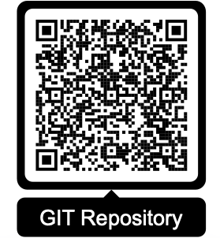
Thank you for your attention!

Slide 33
References
Ali, M. (2023). Quarkus vs. Spring Boot. [online] LogicMonitor. Available at: https://www.logicmonitor.com/blog/quarkus-vs-spring [Accessed 1 Nov. 2025].
DECODE Agency (2024). Quarkus framework: All you need to know | DECODE. [online] DECODE. Available at: https://decode.agency/article/quarkus-framework/ [Accessed 2 Nov. 2025].
Dev, deToxic (2025). Spring Boot vs Quarkus: A Migration Story with Ugly Truths. [online] Medium. Available at: https://blog.stackademic.com/we-switched-from-spring-boot-to-quarkus-heres-the-ugly-truth-c8a91c2b8c53 [Accessed 14 Nov. 2025].
García, A.J. (2025). Spring vs Quarkus: Which is the Best Choice for Your Microservices in 2025? [online] Paradigmadigital.com. Available at: https://en.paradigmadigital.com/dev/spring-vs-quarkus-which-is-best-choice-microservices [Accessed 15Nov. 2025].
Graciano, R. (2019). Baeldung. [online] Baeldung on Kotlin. Available at: https://www.baeldung.com/quarkus-io [Accessed 3 Nov. 2025].
Quarkus.io. (2025). Developer Joy. [online] Available at: https://quarkus.io/developer-joy/ [Accessed 5 Nov. 2025].
quarkus.io. (n.d.). Get Started. [online] Available at: https://quarkus.io/get-started/.
quarkus.io. (n.d.). Guides - Latest. [online] Available at: https://quarkus.io/guides/.
SoftwareMill. (2022). Overview of next-generation Java frameworks. [online] Available at: https://softwaremill.com/overview-of-next-generation-java-frameworks/ [Accessed 11 Nov. 2025].
Venkat Chepuri (2024). Micronaut Vs Helidon Vs Quarkus Vs Spring Boot. [online] Medium. Available at: https://medium.com/@iamvensan/micronaut-vs-helidon-vs-quarkus-vs-spring-boot-4f00b0d4a7ae [Accessed 11 Nov. 2025].
Quarkus.io. (2025). Quarkus Reactive Architecture - main. [online] Available at: https://quarkus.io/version/main/guides/quarkus-reactive-architecture [Accessed 10Nov. 2025].

